Slide 1



US CANDY DISTRIBUTION
CAPSTONE PROJECT
BY TEAM 6
SECTION SABANG

Slide 2
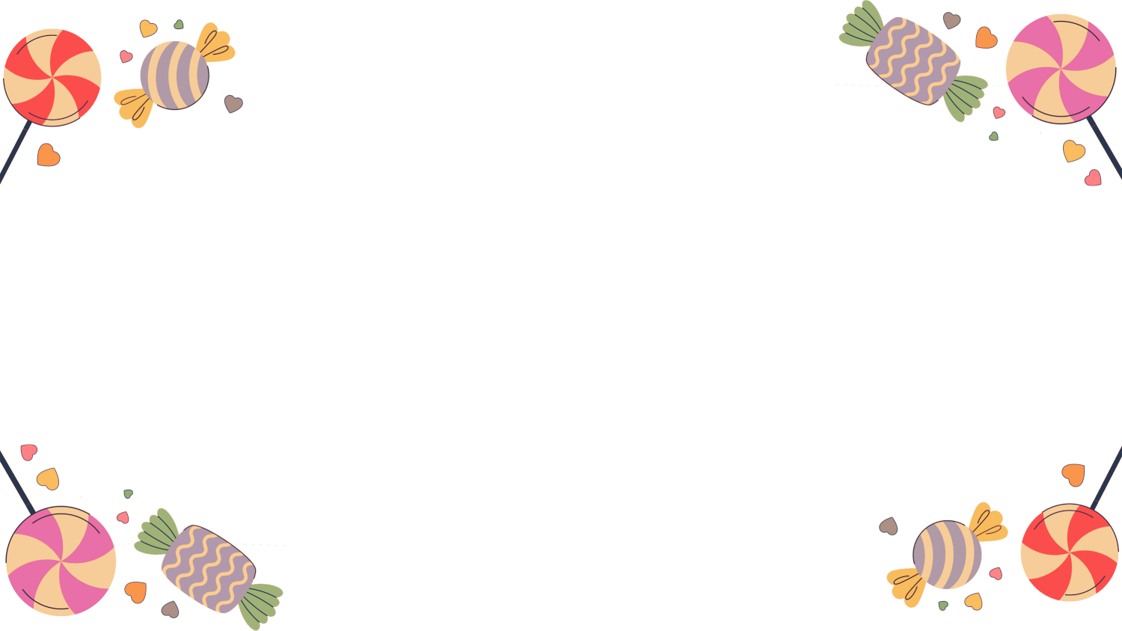









MEMBER OF TEAM 6
Anggi Rizkya Putri
Firda Rahmadani
Priskilla Angel
Data Cleaning
Data Cleaning
Data Cleaning
Irza Maulana Ramadhan
Project Leader
Eka Pramuditya
Safridha Audi Apriliasunfity
Muhammad Halil WiraSani
Data Analyst
Data Analyst
Data Analyst

Slide 3





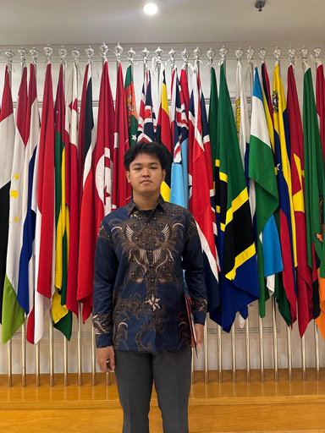
MEMBER OF TEAM 6
Unsiyatul Muhtaromah
Zepanya Putra Hutabarat
Marina Tampubolon
Data Visualization
Data Visualization
Data Visualization
Najwa Faradisa
Amanda Putri Azzahra
Alfito Anugrah Sitohang
Data Presentation
Data Presentation
Data Presentation

Slide 4





TABLE OF CONTENS
01
Executive Summary
05
Data Analysis
02
Project Background
06
Data Visualization
03
Project Goals
07
Insight and recommendation
04
Methodology
08
Appendix

Slide 5






EXECUTIVE SUMMARY
Project Description
Tools
Objective
Improved sales performance by analyzing candy sales by region, product trends, and quarterly performance.
Increase sales of Sugar products by 5% within one year.
Google Spreadsheet
Microsoft
Powerbi

Slide 6


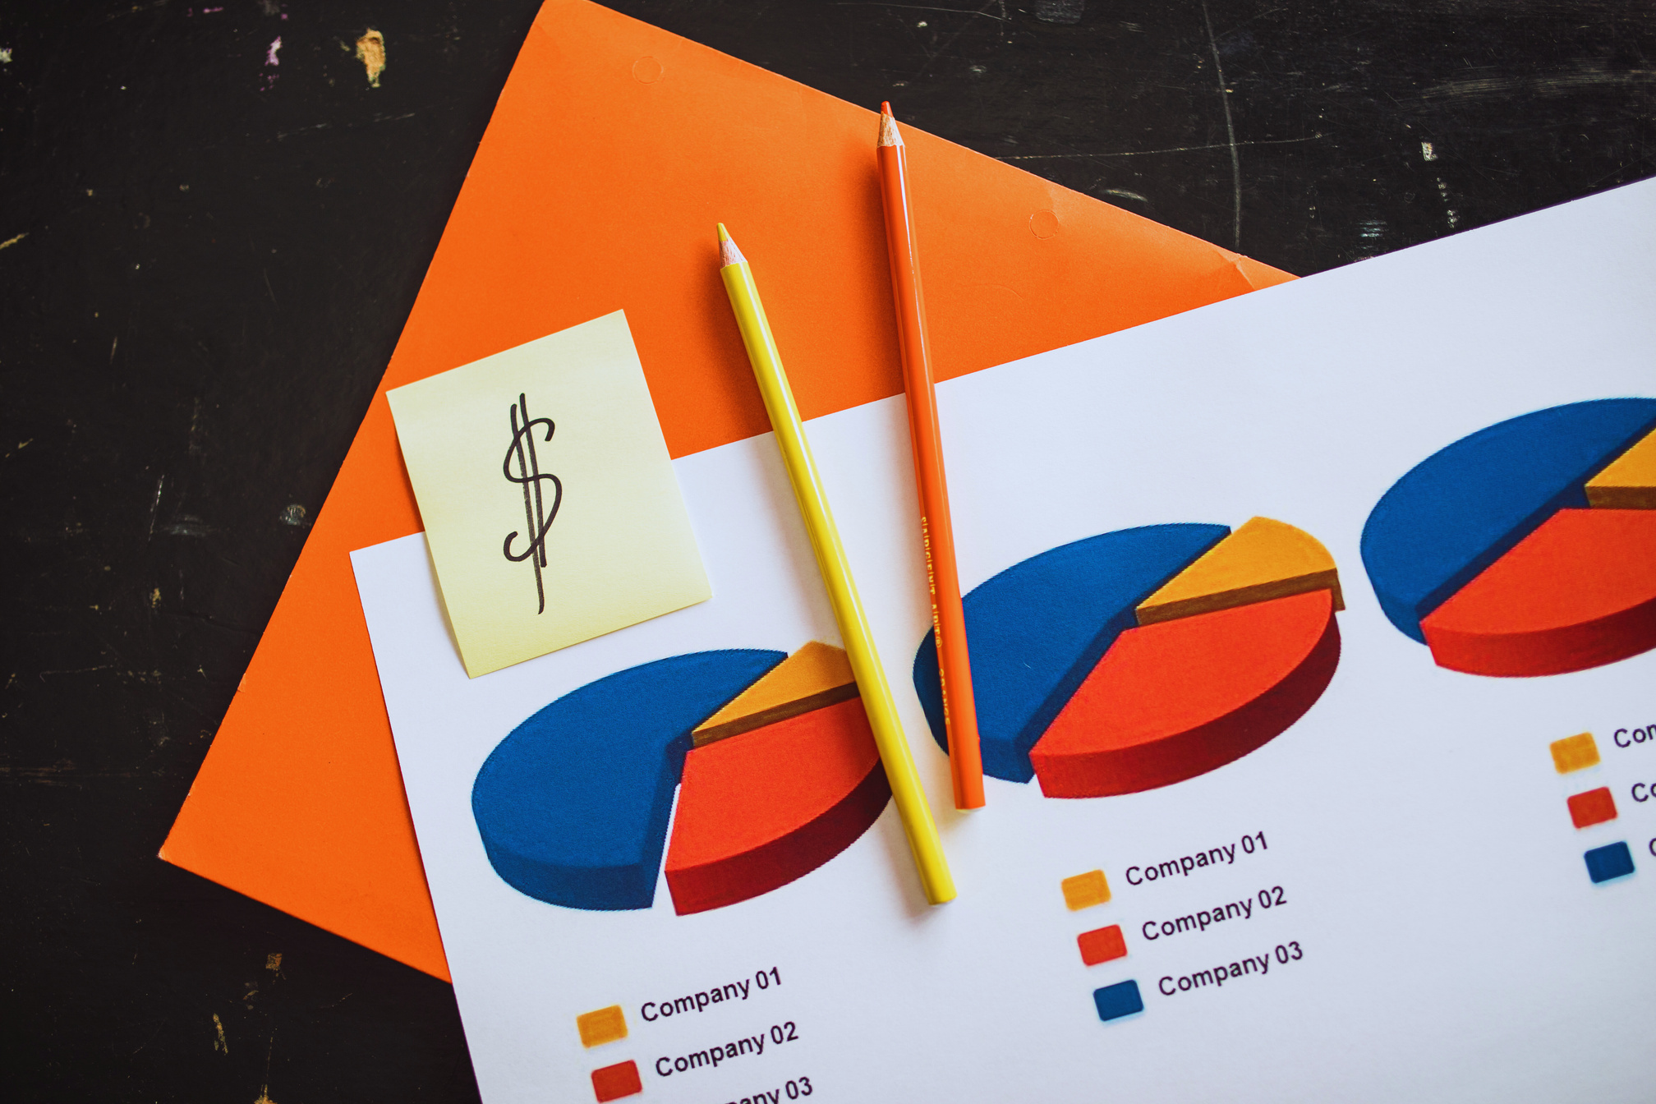
METRICS
Sales
Total Sales: Total revenue from products sold.
Total Orders: The total number of orders received.
Average Order Value: Average value per order.
Profit per Order: Profit earned from each order.
Quantity
Total Qty: The number of units of the product sold.
Qty per Order: Average quantity of product purchased per order.
Units: The number of units sold during a specific period.
Profit
Total Profit: The overall profit from the sale of the product.
Gross Profit: Net profit earned.
Profit per Order: Profit per order received.
Cost per Order: The cost incurred from each order.

Slide 7

PROJECT BACKGROUND
Project Objectives
Analyzed sales of Sugar products in various regions in the US & Canada, to increase sales that did not reach the set targets.
Project Scope
Sales data from January 01, 2021 to December 31, 2024.
Includes region, product, price, division and plant information across the US.
Method Used
Analyze the data using the pivot data method to understand the factors that influence sales, including region, price, and product popularity.
Expected Output
Develop effective marketing strategies, such as product bundling and loyalty programs, to increase sales of Sugar products in potential regions.

Slide 8

PROJECT GOALS
Objective
Scope
Increase sales of Sugar products by 5% in one year with bundling, royalty points, and discount strategies.
All US candy sales data from January 3, 2021 to December 31, 2024.

Slide 9



ROOT CAUSE ANALYSIS
How to increase sugar sales by 5% within one year?
Sales Region
Product
Sales Period
Sales Region
Strategy Innovation
Product
Kuartal
Month
Promotion
After-Sales
Popularity
Profitability
Kuartal
Kuartal
Contribution
Promotion
After-Sales
Popularity
Profitability
Month
Root Cause Analisis

Slide 10








METHODOLOGY
Understand Business Problem
01
02
Data Cleaning & Analysis
Insight and Recommendations
04
03
Data Visualization

Slide 11
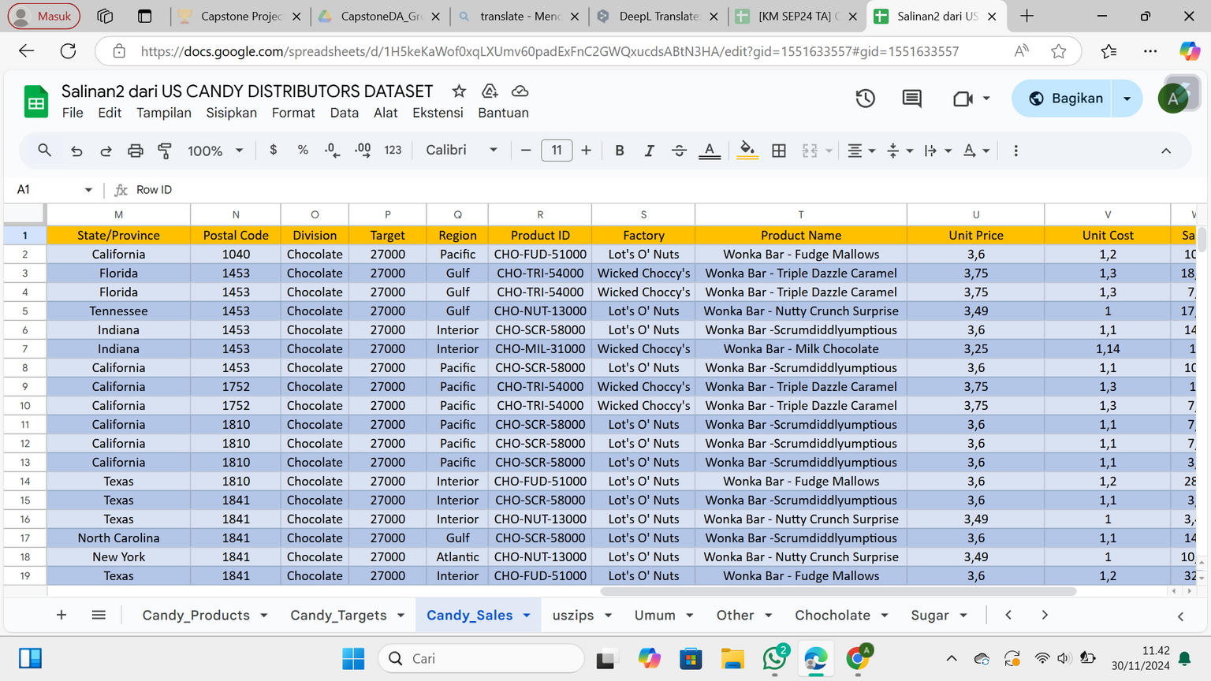



DATASET CANDY SALES
Data Source
US Candy Distributor
Contains sales data of Candy products in the United States and Canada including details of Chocolate, Sugar, Other and target product divisions.
Sales data
January 3, 2021 - December 30, 2024
Data Source : Data Analisis

Slide 12

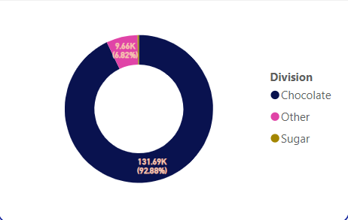
DATA ANALYSIS
Sales Contribution By division in 2021-2024
Sales distribution is uneven, dominated by the Chocolate Division.
Sugar Division's performance is the lowest, with minimal contribution.
Significant contribution gaps exist between divisions.

Slide 13

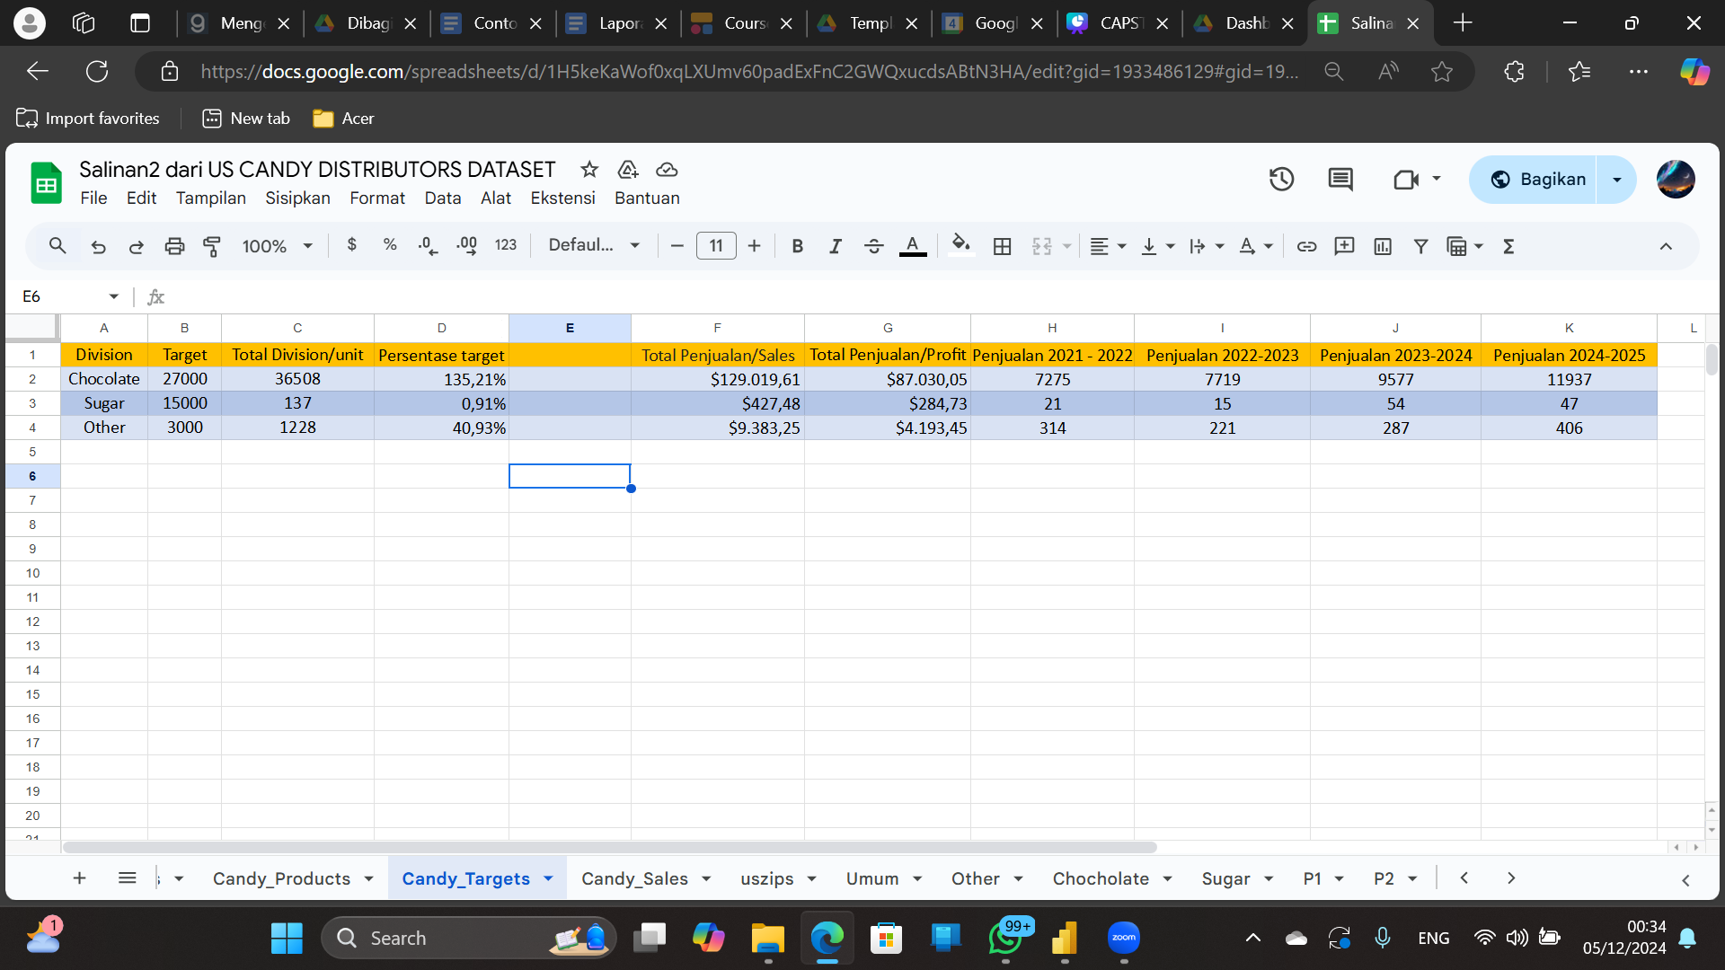
DATA ANALYSIS
Target By Division
Target By Division
The dominance of the Chocolate Division's sales performance, which has far exceeded the sales target
The very low performance of the Sugar Division, indicating the minimal contribution to total sales.

Slide 14

DATA ANALYSIS
The Sugar Division's sales performance did not meet expectations, this was due to :
Low Sales Contribution
Low Sales Contribution
Low Sales Contributions
Low Target Achievement
Low Target Achievements
Reflecting minimal impact on overall performance, the Sugar Division accounted for only 0.30% of total sales.
Highlighting significant underperformance, The division achieved just 0.91% of its sales target
Therefore, it is necessary to analyze the sales of the Sugar division to identify the factors that cause low sales performance.

Slide 15
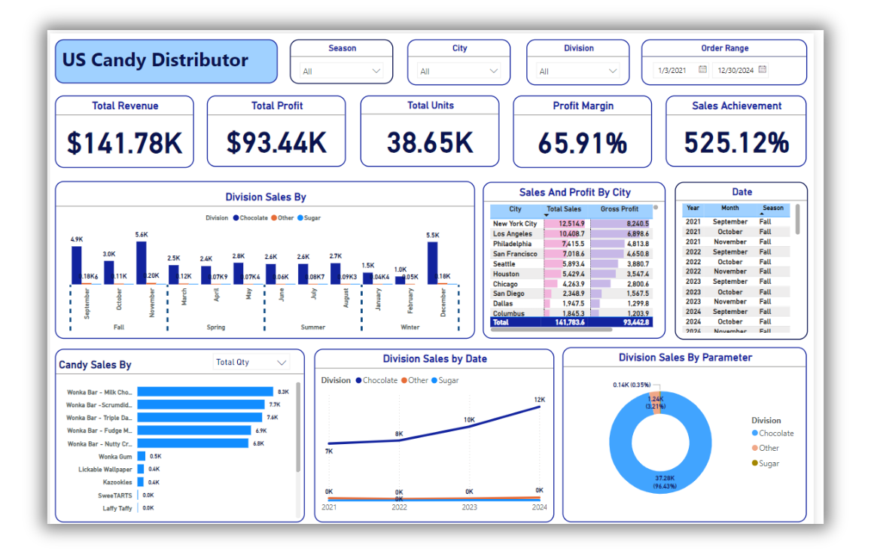
DATA VISUALIZATION
Dashboard Tim 6

Slide 16
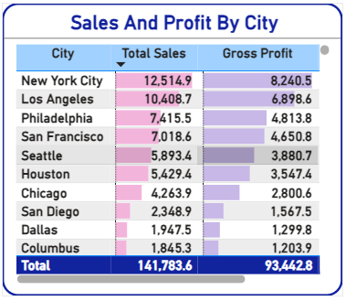
DATA VISUALIZATION
Total Sales & Profit by City
New York City dominates sales
Pueblo City recorded the highest profit
Diversification of contribution between cities is still low

Slide 17
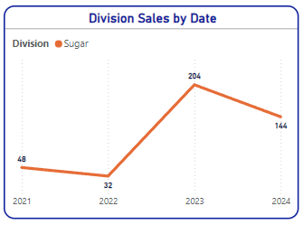
DATA VISUALIZATION
Total Sales By division in 2021-2024
.
2021-2022: Experienced a decline in sales
2022-2023: Experienced a surge in sales.
2023-2024: Experienced a decline in sales.

Slide 18

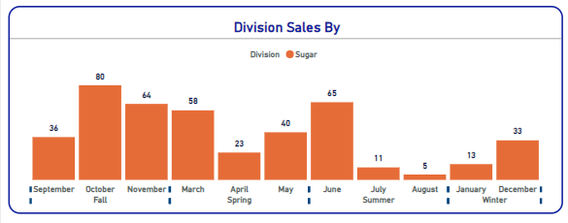
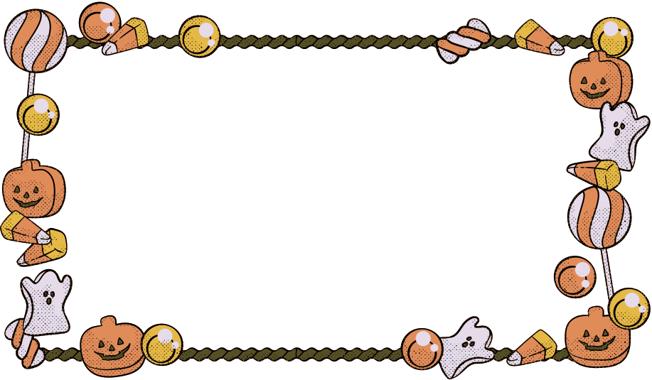

DATA VISUALIZATION
Target By Division
Sales by Division by Season
Uneven sales distribution, with peaks occurring only in specific seasons.
Significant dominance of sales contribution in Autumn
Lack of Sales Contribution in the Winter Season

Slide 19
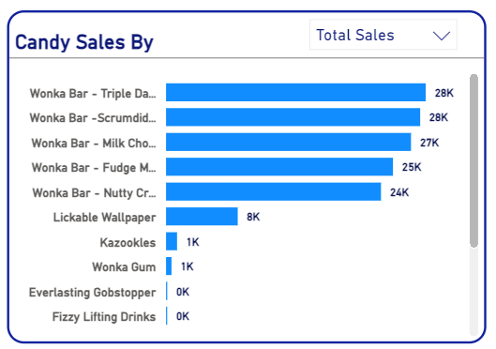
DATA VISUALIZATION
Sales by Product
Everlasting Gobstopper's dominance
Fun Dip’s poor sales performance
Significant disparity between the highest and lowest selling products

Slide 20

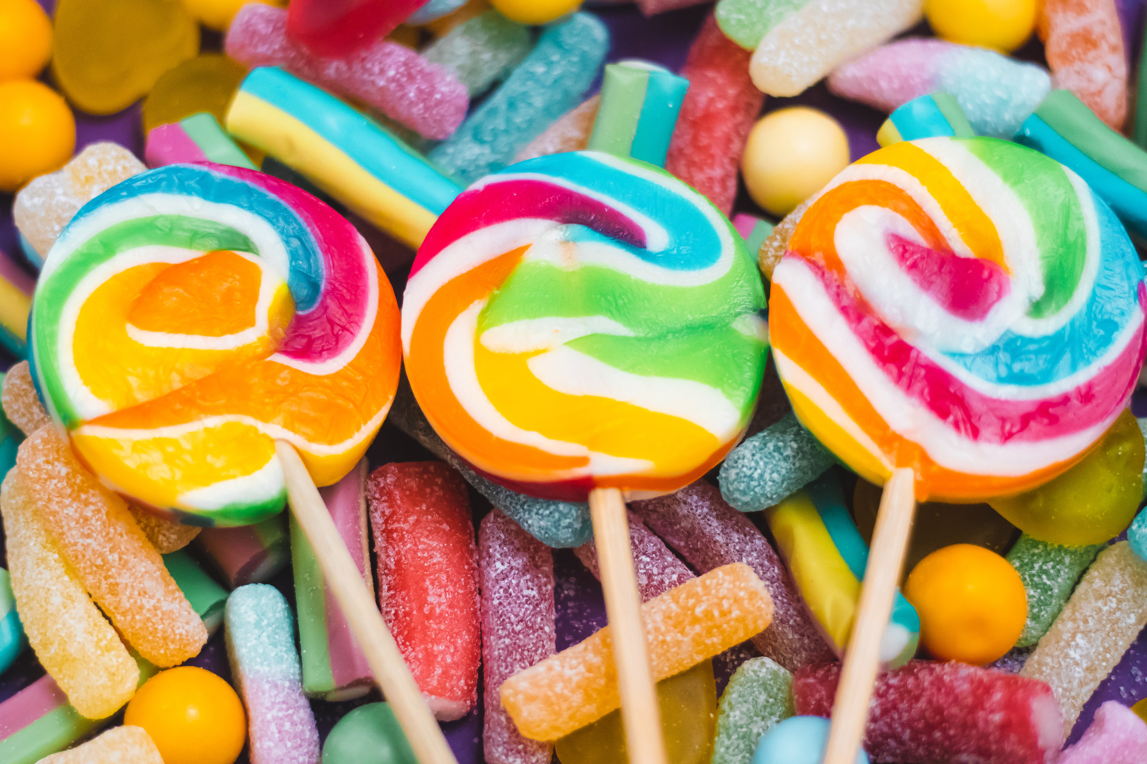
CONSCLUSION
The Chocolate Division's dominance in sales amounted to 92.88%, while on the other hand, Sugar was the division with the lowest sales contribution with only 0.30%.
The sugar division's sales stagnated from 2021 to 2024, far behind the significant growth of the chocolate and other divisions.
Fall as Peak Sales Period The highest sales occur in the fall, especially in October ($19.6K) and November ($19.5K).
New York City recorded the highest total sales of $12,514, with the largest gross profit of $8,240.5, making it the most significant region in revenue contribution.

Slide 21
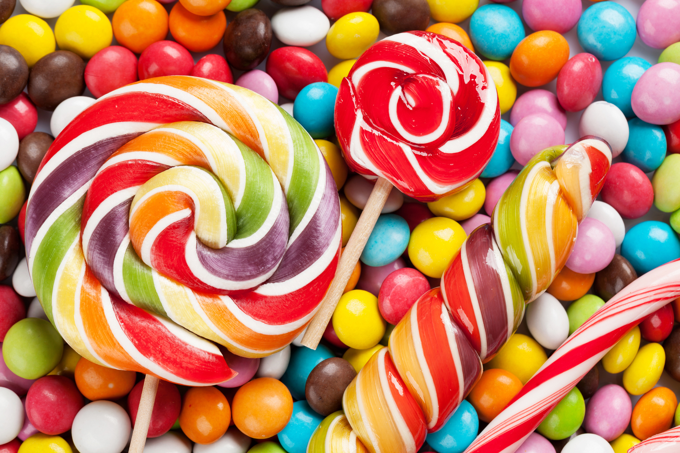
INSIGHT
Sales Growth Trends, with One division shows rapid growth, while another remains stagnant.
Product Trends, Some products achieve high sales, while others underperform significantly.
Seasonal trends, heavily influence sales performance.
Major Cities Trends, contribute significantly to total sales.

Slide 22
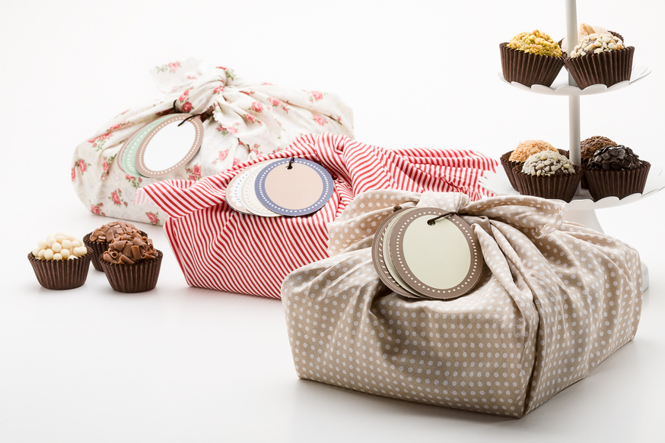

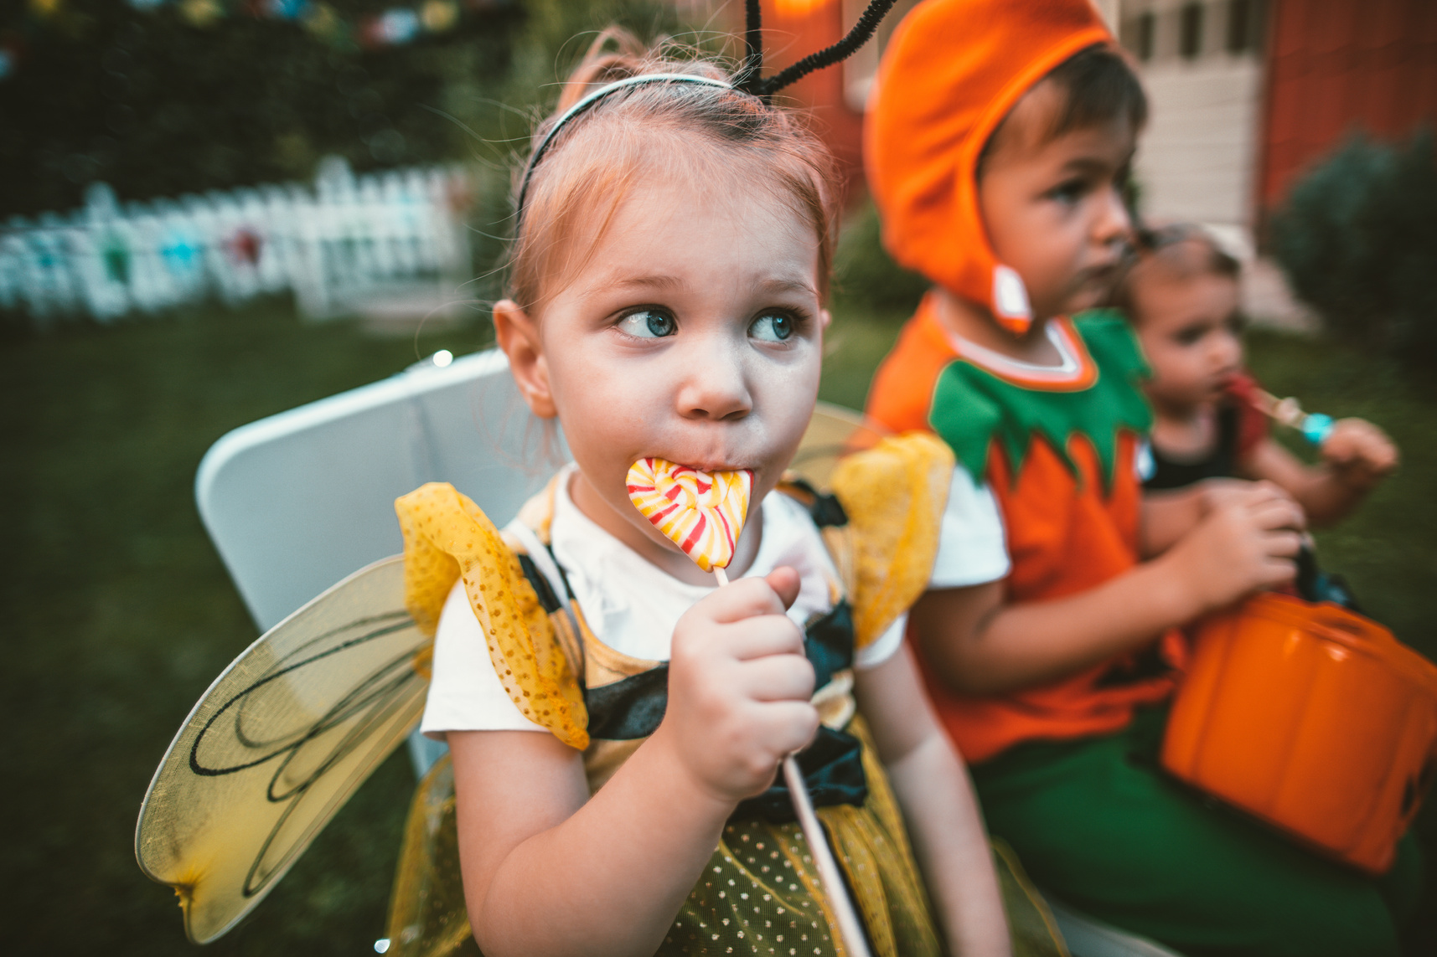
RECOMMENDATION
Product Marketing Strategy Innovation in areas with the highest sales
Example: Bundle sale offer of 3 Wonka Bar – Scrumdiddlyumptious and 1 Laffy Taffy with a 10% discount during June–August.
After-Sales Program innovation for every purchase transaction made
Example: "Get a free sugar product! Redeem 10 points you've earned from every $10 spent on sugar products."
Seasonal Promotional Event Innovations that are relevant in certain periods/quarters
Example: Autumn Sales! "Buy 3 boxes of SweeTarts, get 5 more pieces for free!"

Slide 23
Thank you
Together, We Sweeten the Future of Sugar Sales!
Let’s take action, drive growth, and make the next year even sweeter.
We’re ready for the challenge
—are you?

Slide 24





APPENDIX
Dataset
RCA
Analysis
Dashboard

